Slide 1

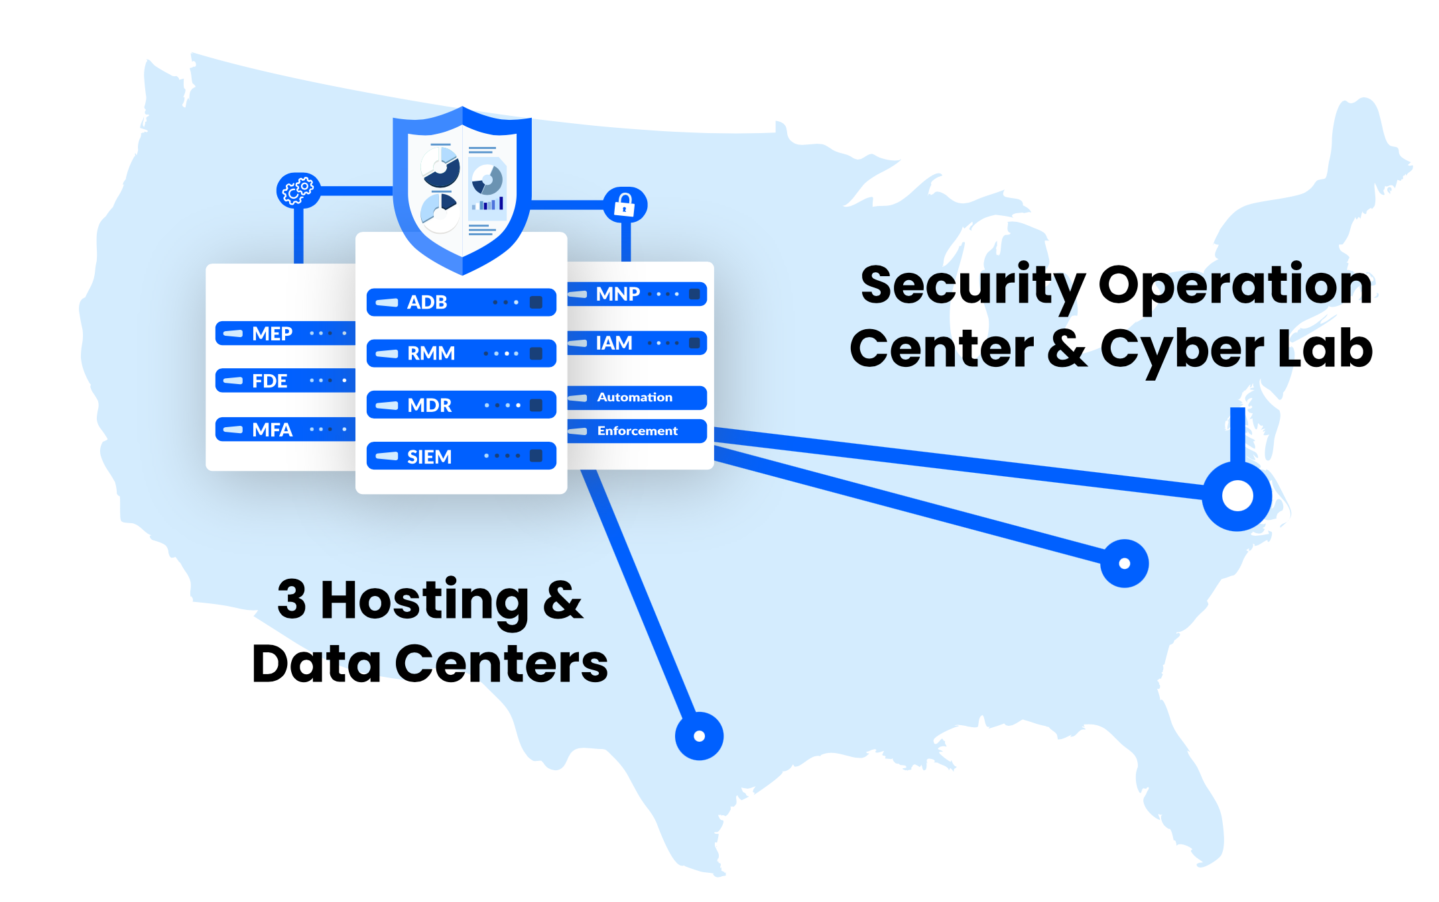
Cybersecurity Incident Response Process
Cybersecurity
Protection &
Compliance

Slide 2
Cybersecurity Incident Response Process
FCI takes the following steps in response to any Incident reported to us by a client:
FCI begins to assess imminent risks created by Incident
FCI makes immediate recommendations to secure the environment from further intrusion
FCI makes notification and reporting recommendations based on regulatory requirements
FCI walks Client through steps to complete preservation of evidence
Client completes FCI Incident Response Intake Form
FCI uses Intake Form to adapt Incident Response project
Scope of FCI work is defined and agreed upon by all parties involved
FCI begins data collection and evidence gathering process
FCI performs interview with impacted personnel and client’s lead contact along with any additional parties involved
FCI prepares report, makes determination, and delivers to Client with supporting evidence
FCI makes additional recommendations to Client
Upon acceptance of recommendations, FCI will assist in the implementation of recommendations as needed
www.fcicyber.com info@fcicyber.com 1-888-434-6443

Slide 3
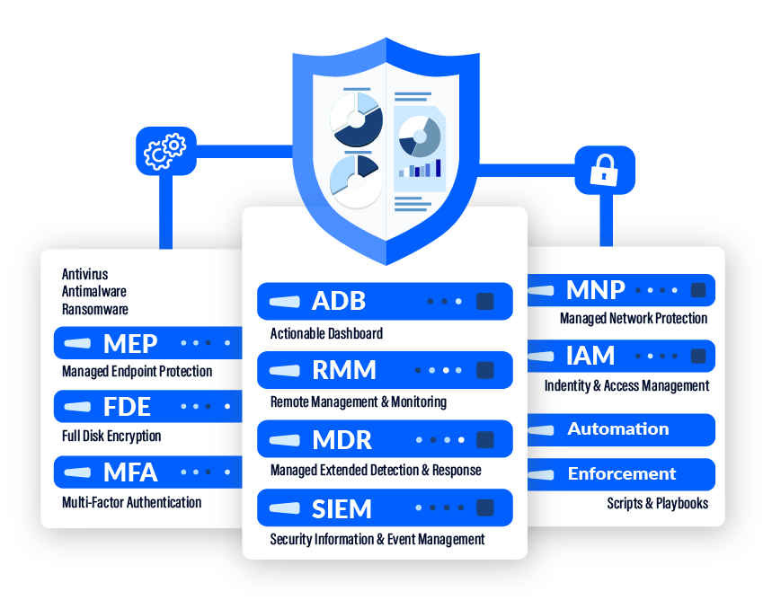
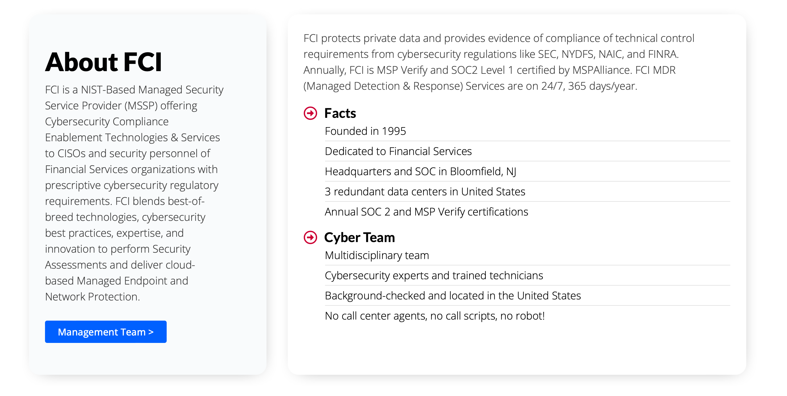
www.fcicyber.com info@fcicyber.com 1-888-434-6443

